Slide 1
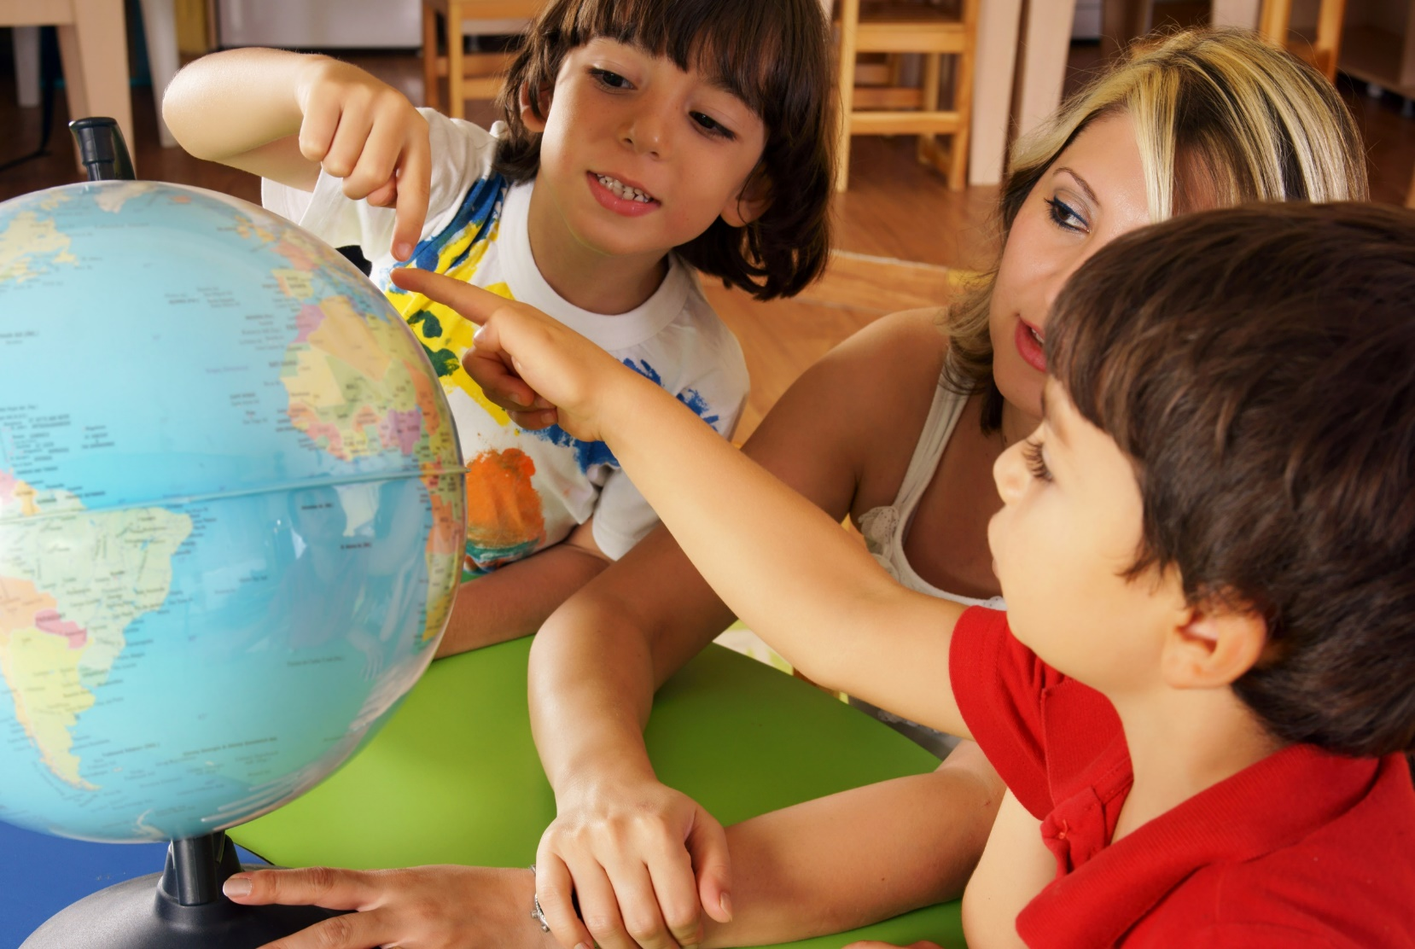
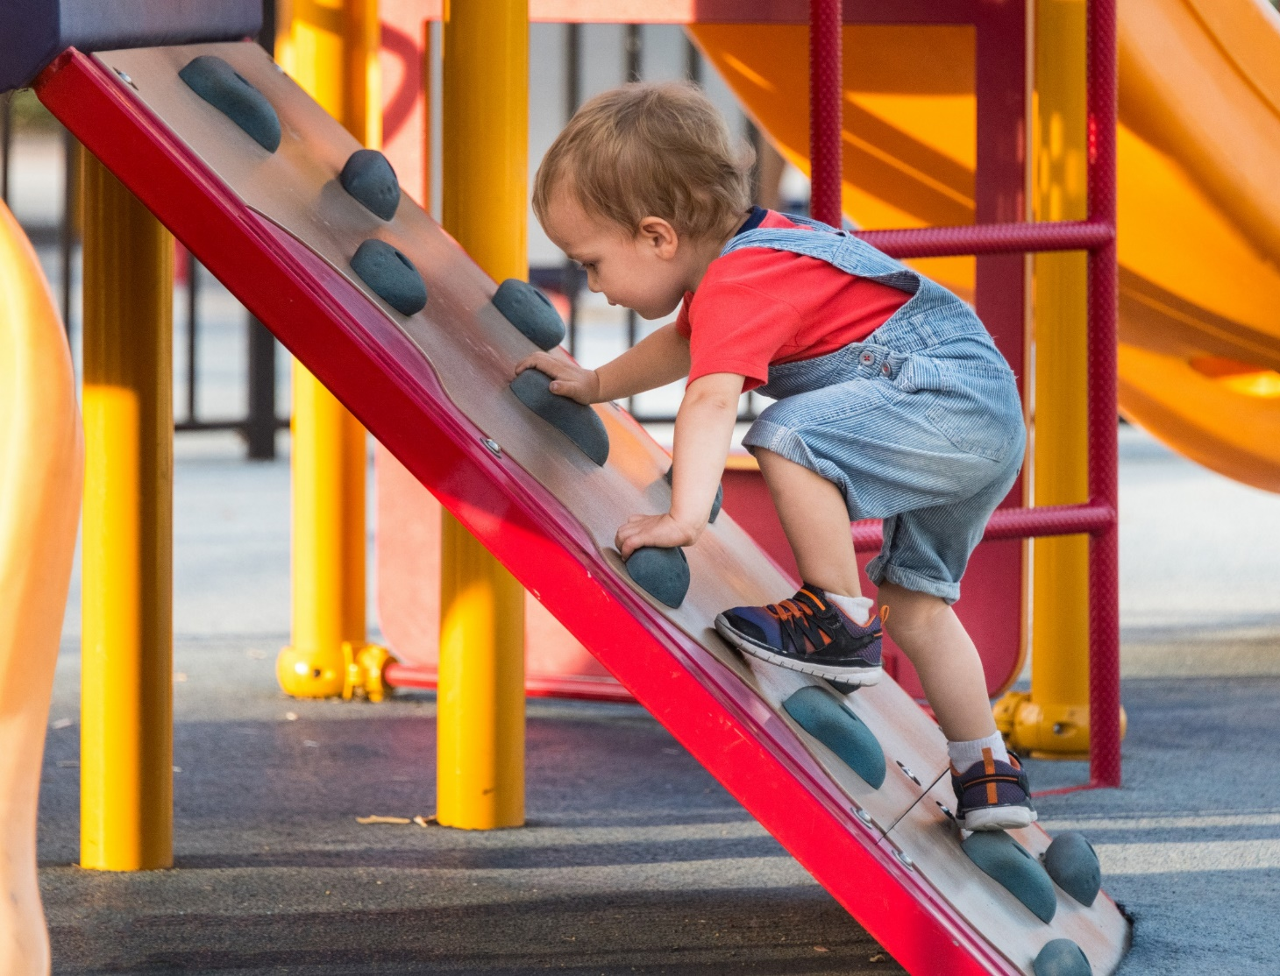
Multiple Exposures The numeracy of very young children becomes embedded in long term memory with multiple exposures. For example, the language of location can be reinforced continually by parents and educators through multiple encounters, providing immediate feedback within a variety of different situations or settings.

Slide 2
Reading Family members, child carer workers and educators read books, such as ‘The Bear Hunt’ and ‘Rosie’s Walk’ to children from birth. Using actions while reading these books reinforces location words such as, ‘over’, ‘under’, ‘in’, etc. Explicit use of location and directional language through inviting children to point to and identify objects that are ‘beside’, ‘next to’, ‘on top of’ is beneficial in developing spatial understanding.

Slide 3
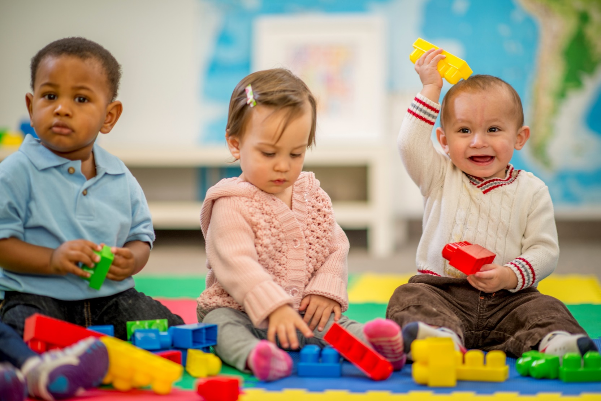
Block Play During block play, parents or educators label the child’s actions and encourage engagement in opportunities for the language of location to be strengthened, ‘You are putting the orange block ‘on top of’ the red block’, ‘Place the yellow block ‘next to’ the blue block.’

Slide 4
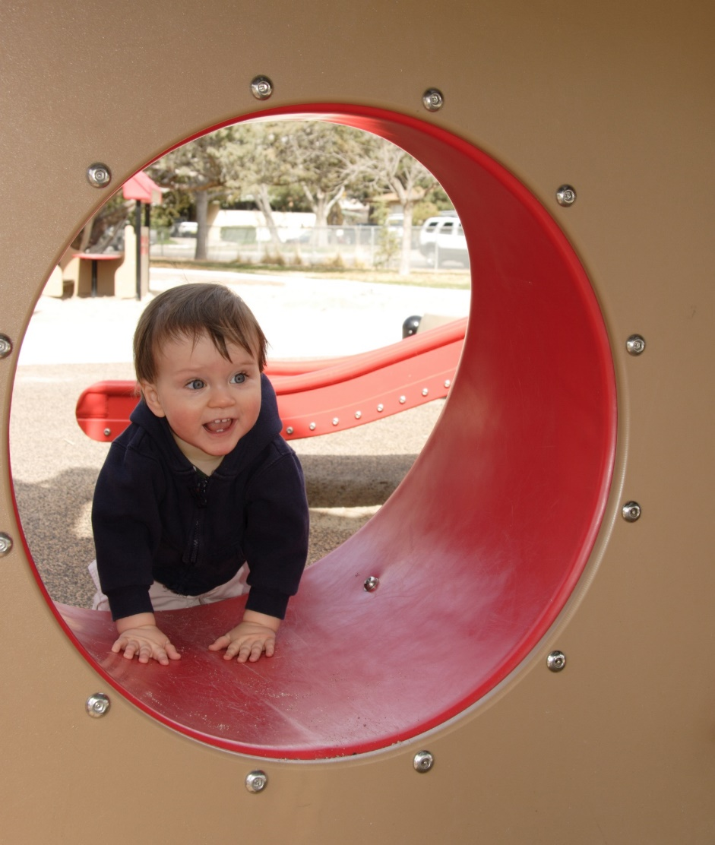
Outdoor Play Playing on climbing equipment and going through obstacle courses provide other opportunities to emphasise the language of location. When children hear the words while engaged in the actions they are more likely to conceptualise the meaning – ‘You are going ‘through’ the tunnel.’ ‘Anika is on the left side of the swings.’

Slide 5
Everyday Routines Multiple exposures to location language can be reinforced during daily routines – ‘Place your drink bottle ‘next to’ your lunch box’, ‘Put your shoes ‘outside’ the door’, ‘Move ‘forward’ so that you are standing ‘between’ Kwesi and Tiantian.’

